Slide 1
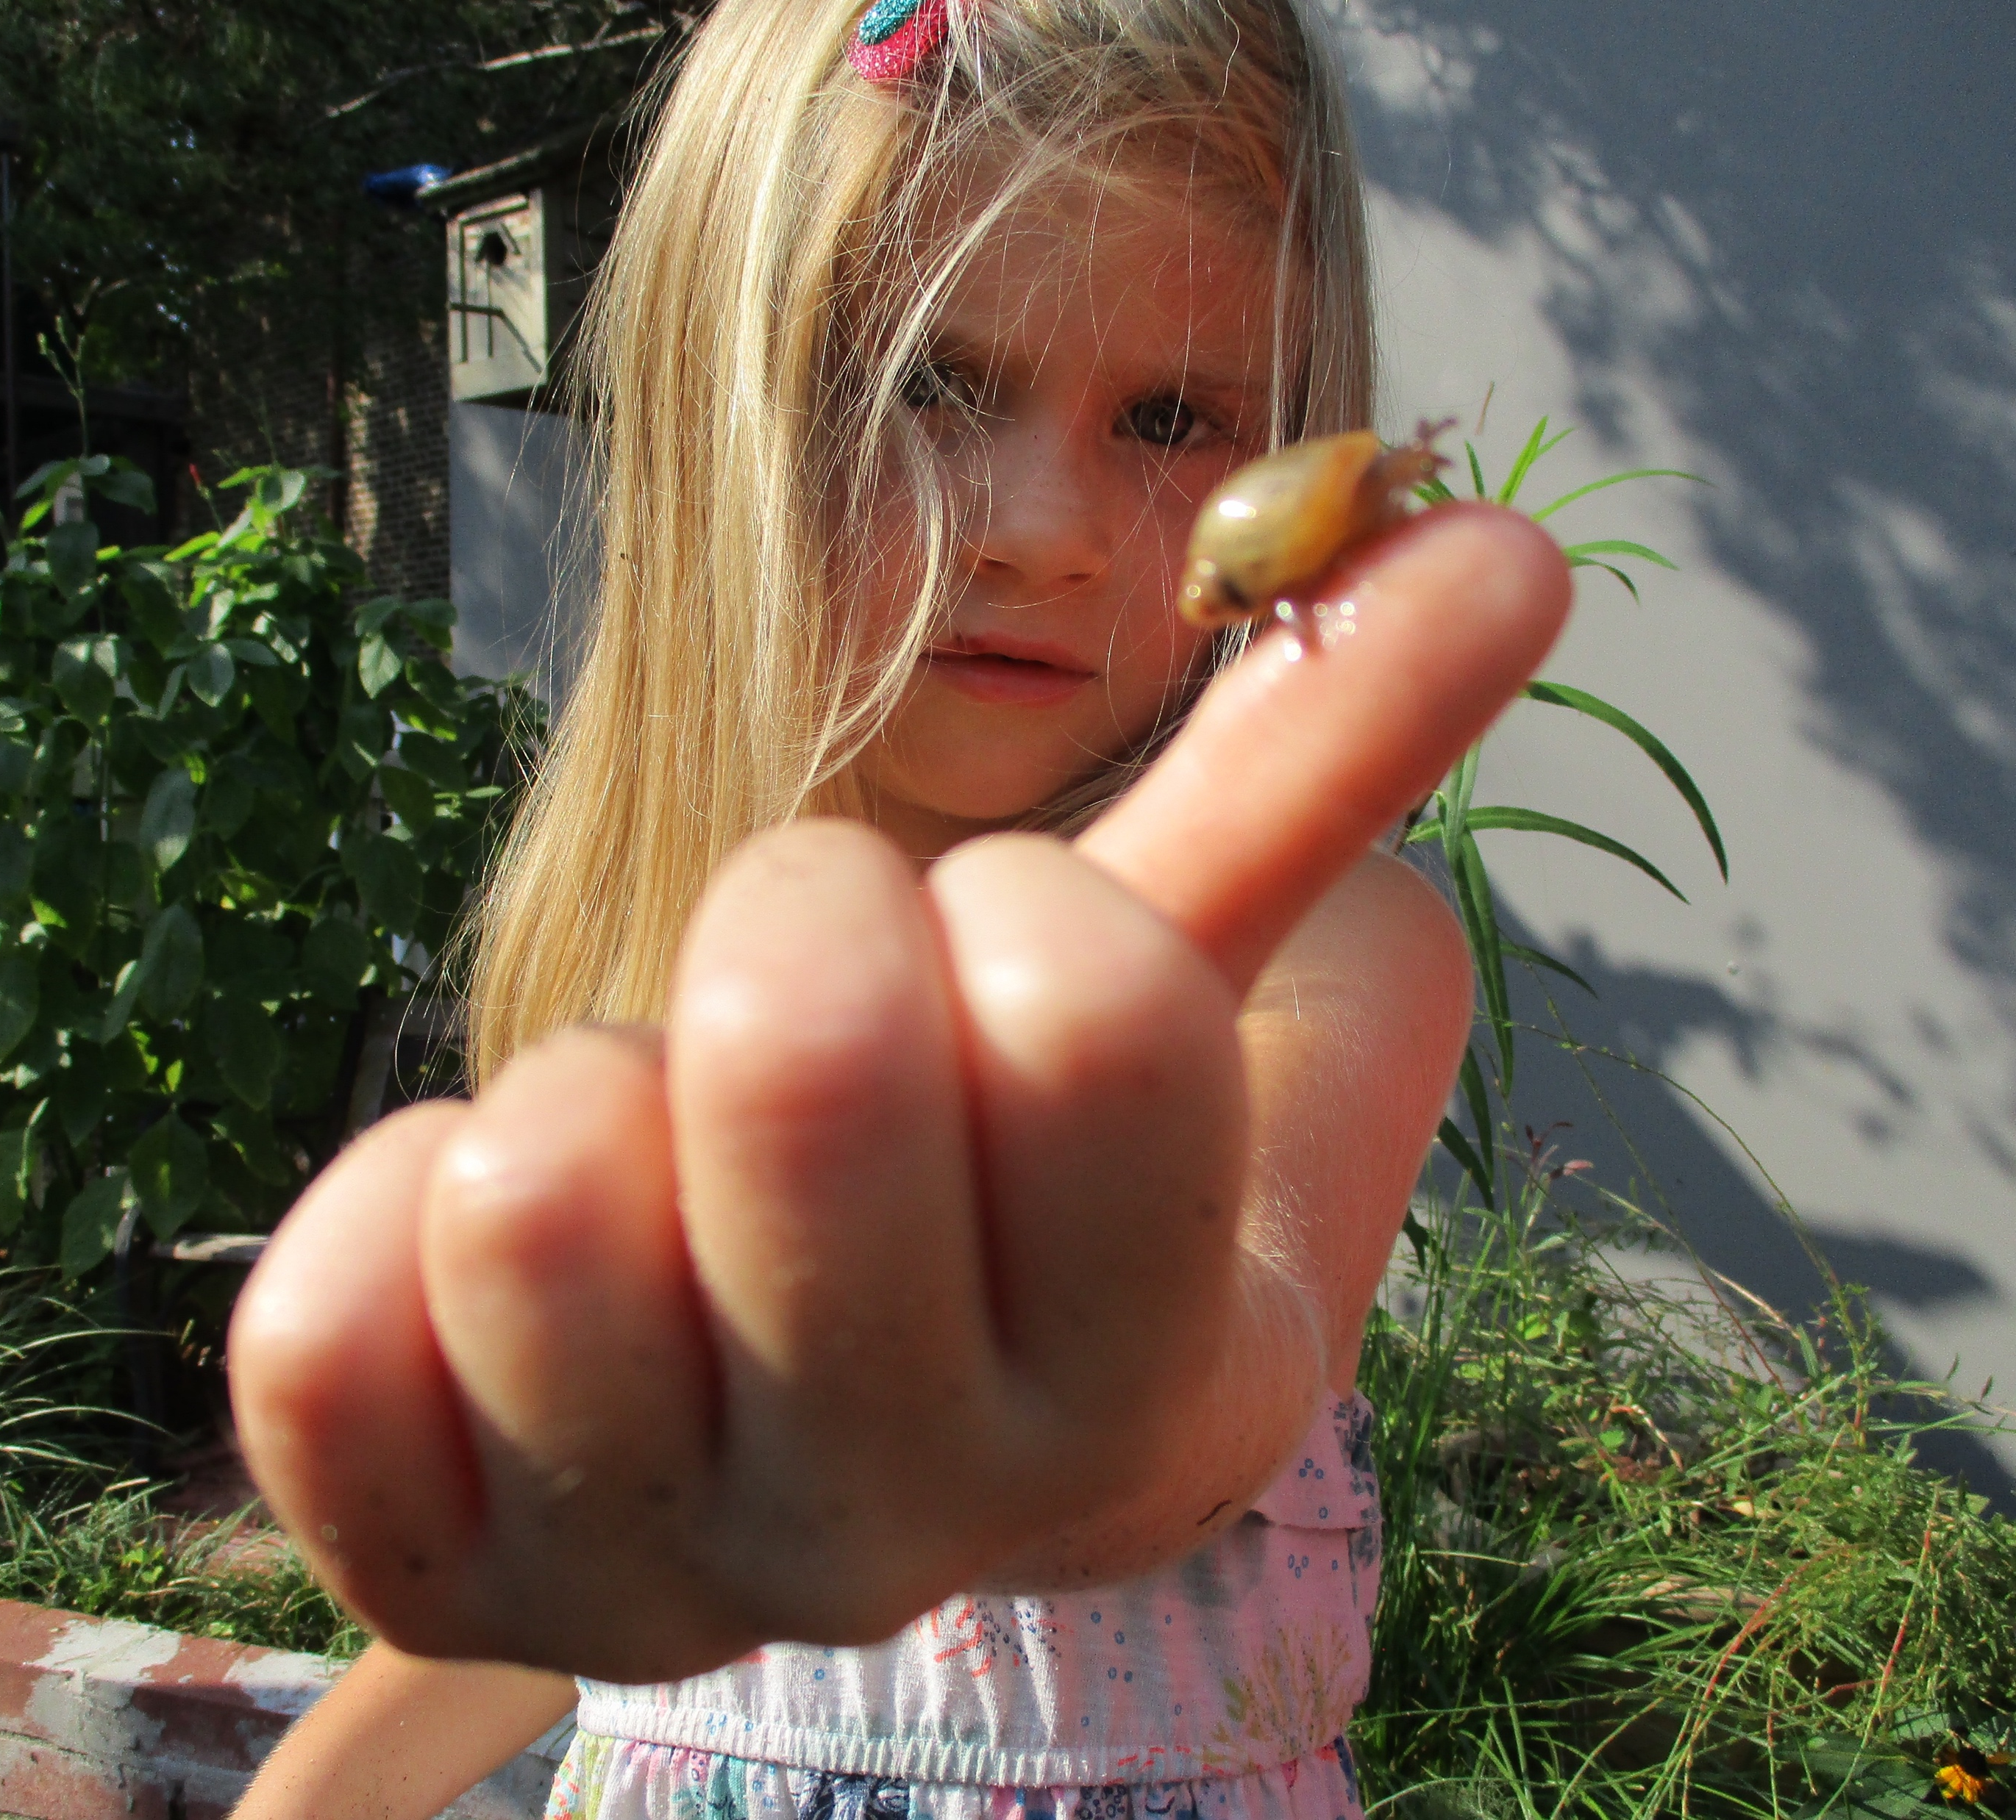
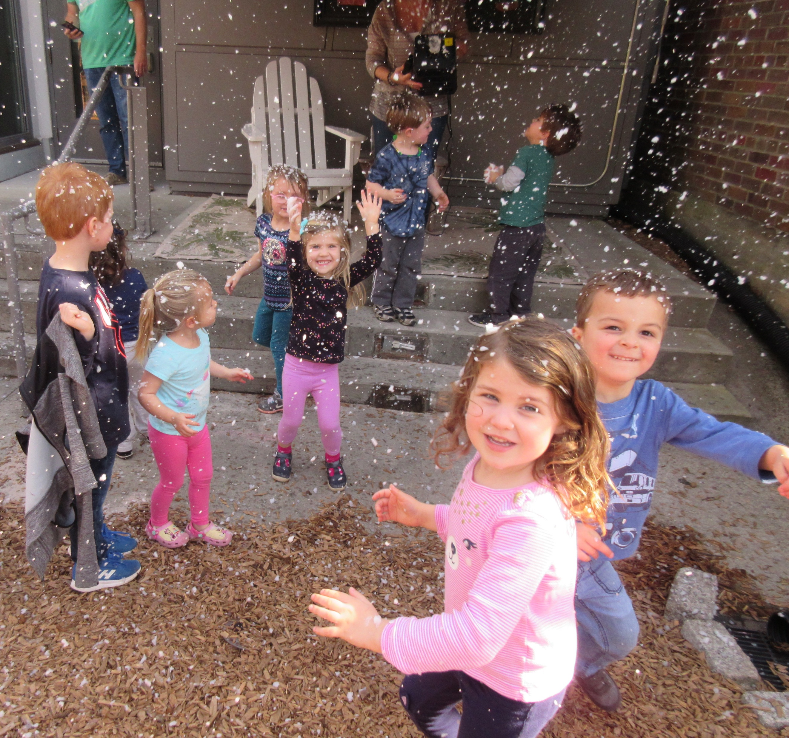
N.E. Miles ECDC College of Charleston
2020 Recertification Application
Nature Explore

Slide 2
Commitment
We are grateful for the opportunity to annually renew our Nature Explore certification, as the process helps us maintain focus on continued improvement. As a campus-based demonstration and laboratory program, we have a responsibility to model best practices in our community, including connecting children with the natural world. Our efforts focus on commitment to 3 “big ideas”
Sustainability & ecological responsibility
Loose parts play
Collaborations within and external to our campus
The following slides share highlights of our work in 2019-20 on these ideas
7.31.20.NE_Recertification

Slide 3
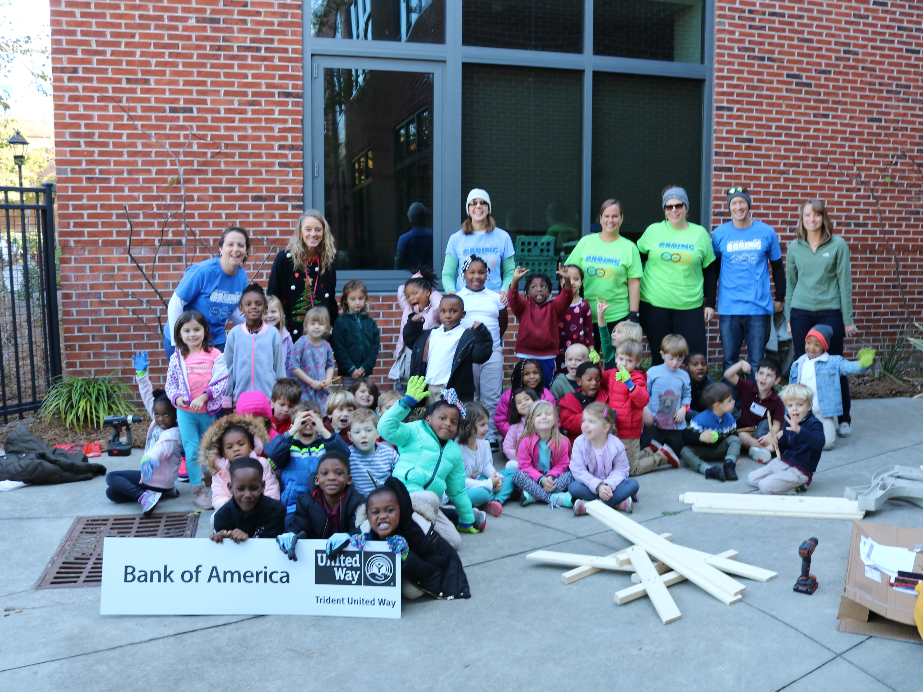
Peace Project
The Peace Project evolved this year to include the local community. We hosted the annual “Day of Caring” and together we cleaned and designed the outdoor shared space between the two schools.

Slide 4
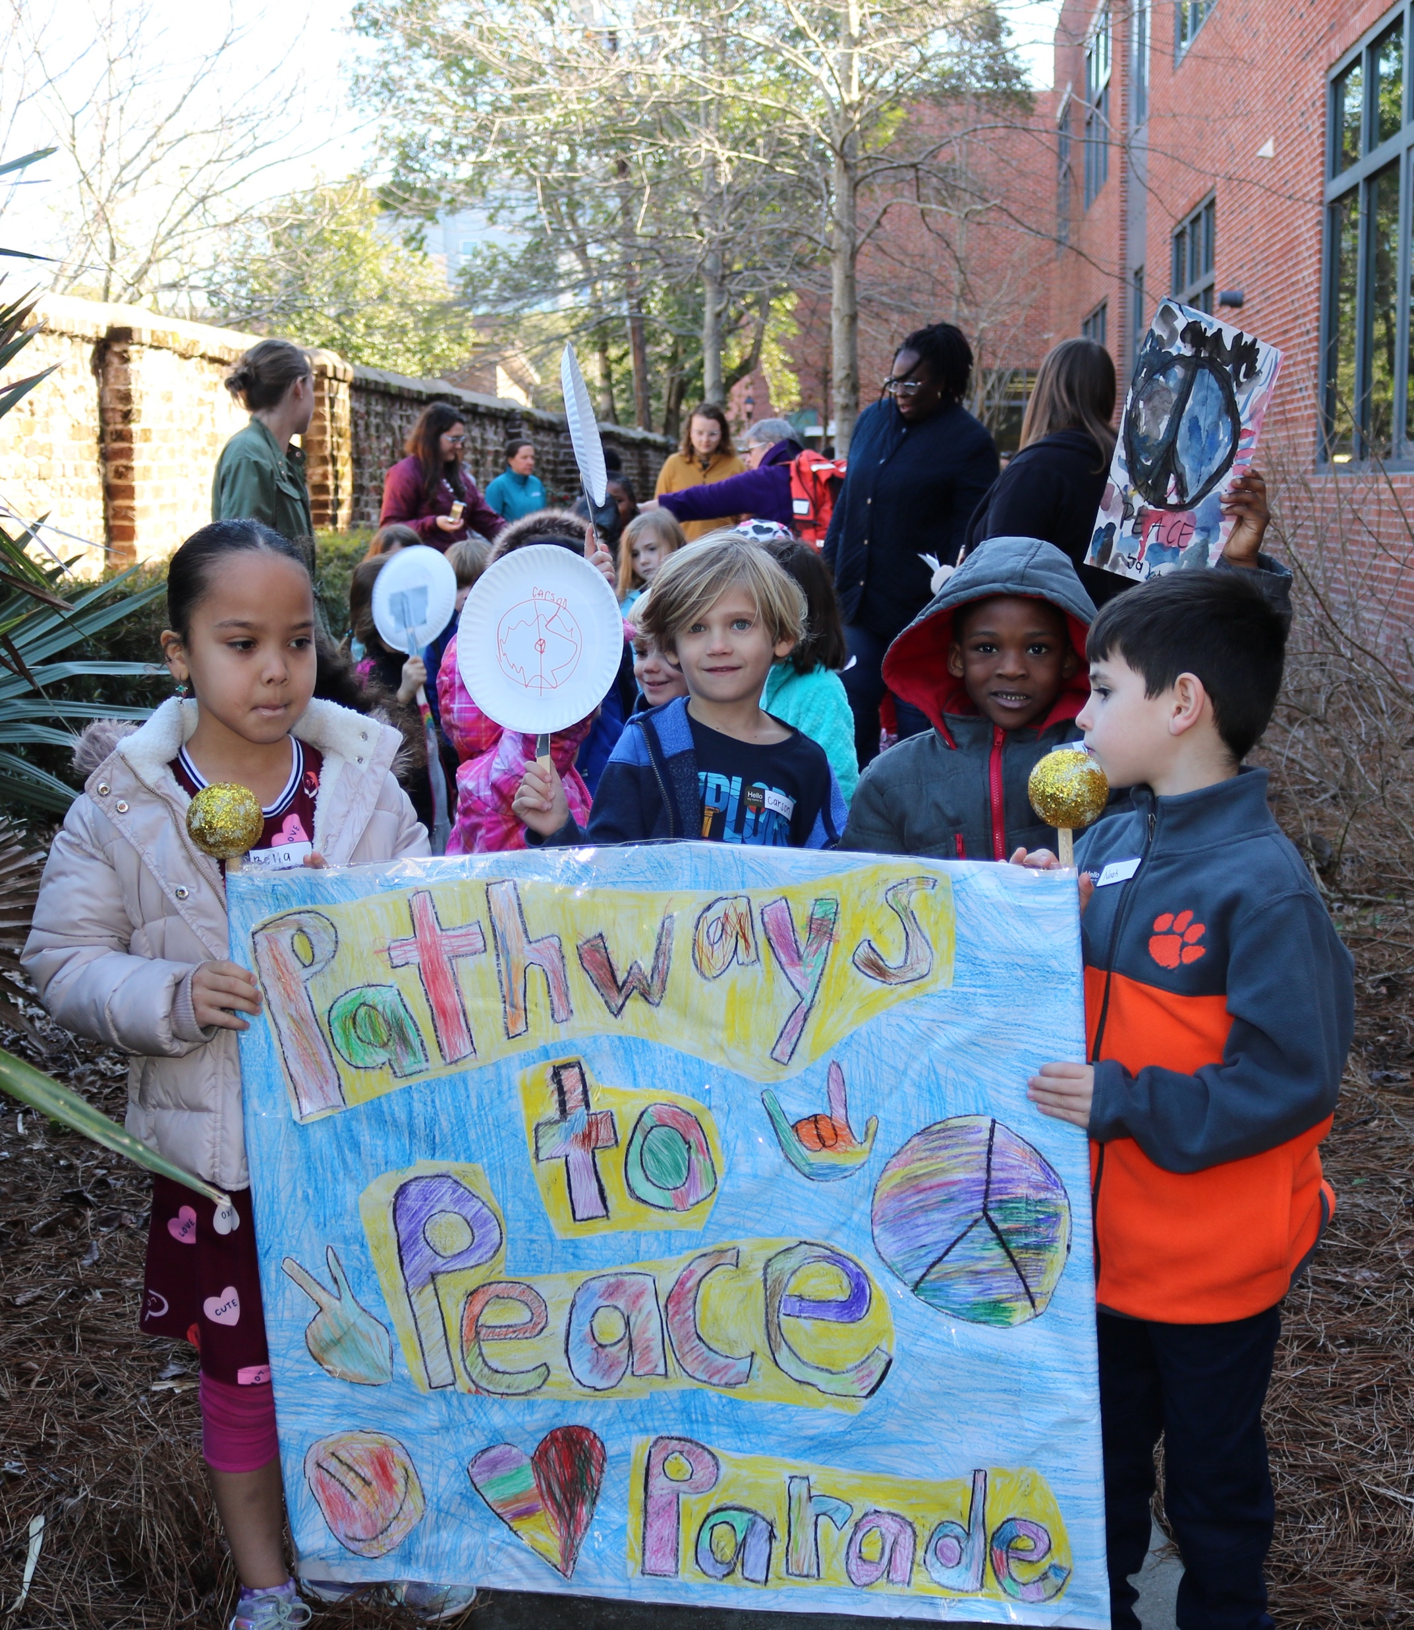
Peace Project
Last year we developed our relationship with our neighboring school and opened our “gate” between the schools to host play dates and learn more about each other. This year we celebrated this commitment and explored the concept of friendship by creating our Peace garden. In the spring, we celebrated our shared space by marching through our Peace garden during our annual campus “Peace Parade” to honor peace and inclusivity.

Slide 5
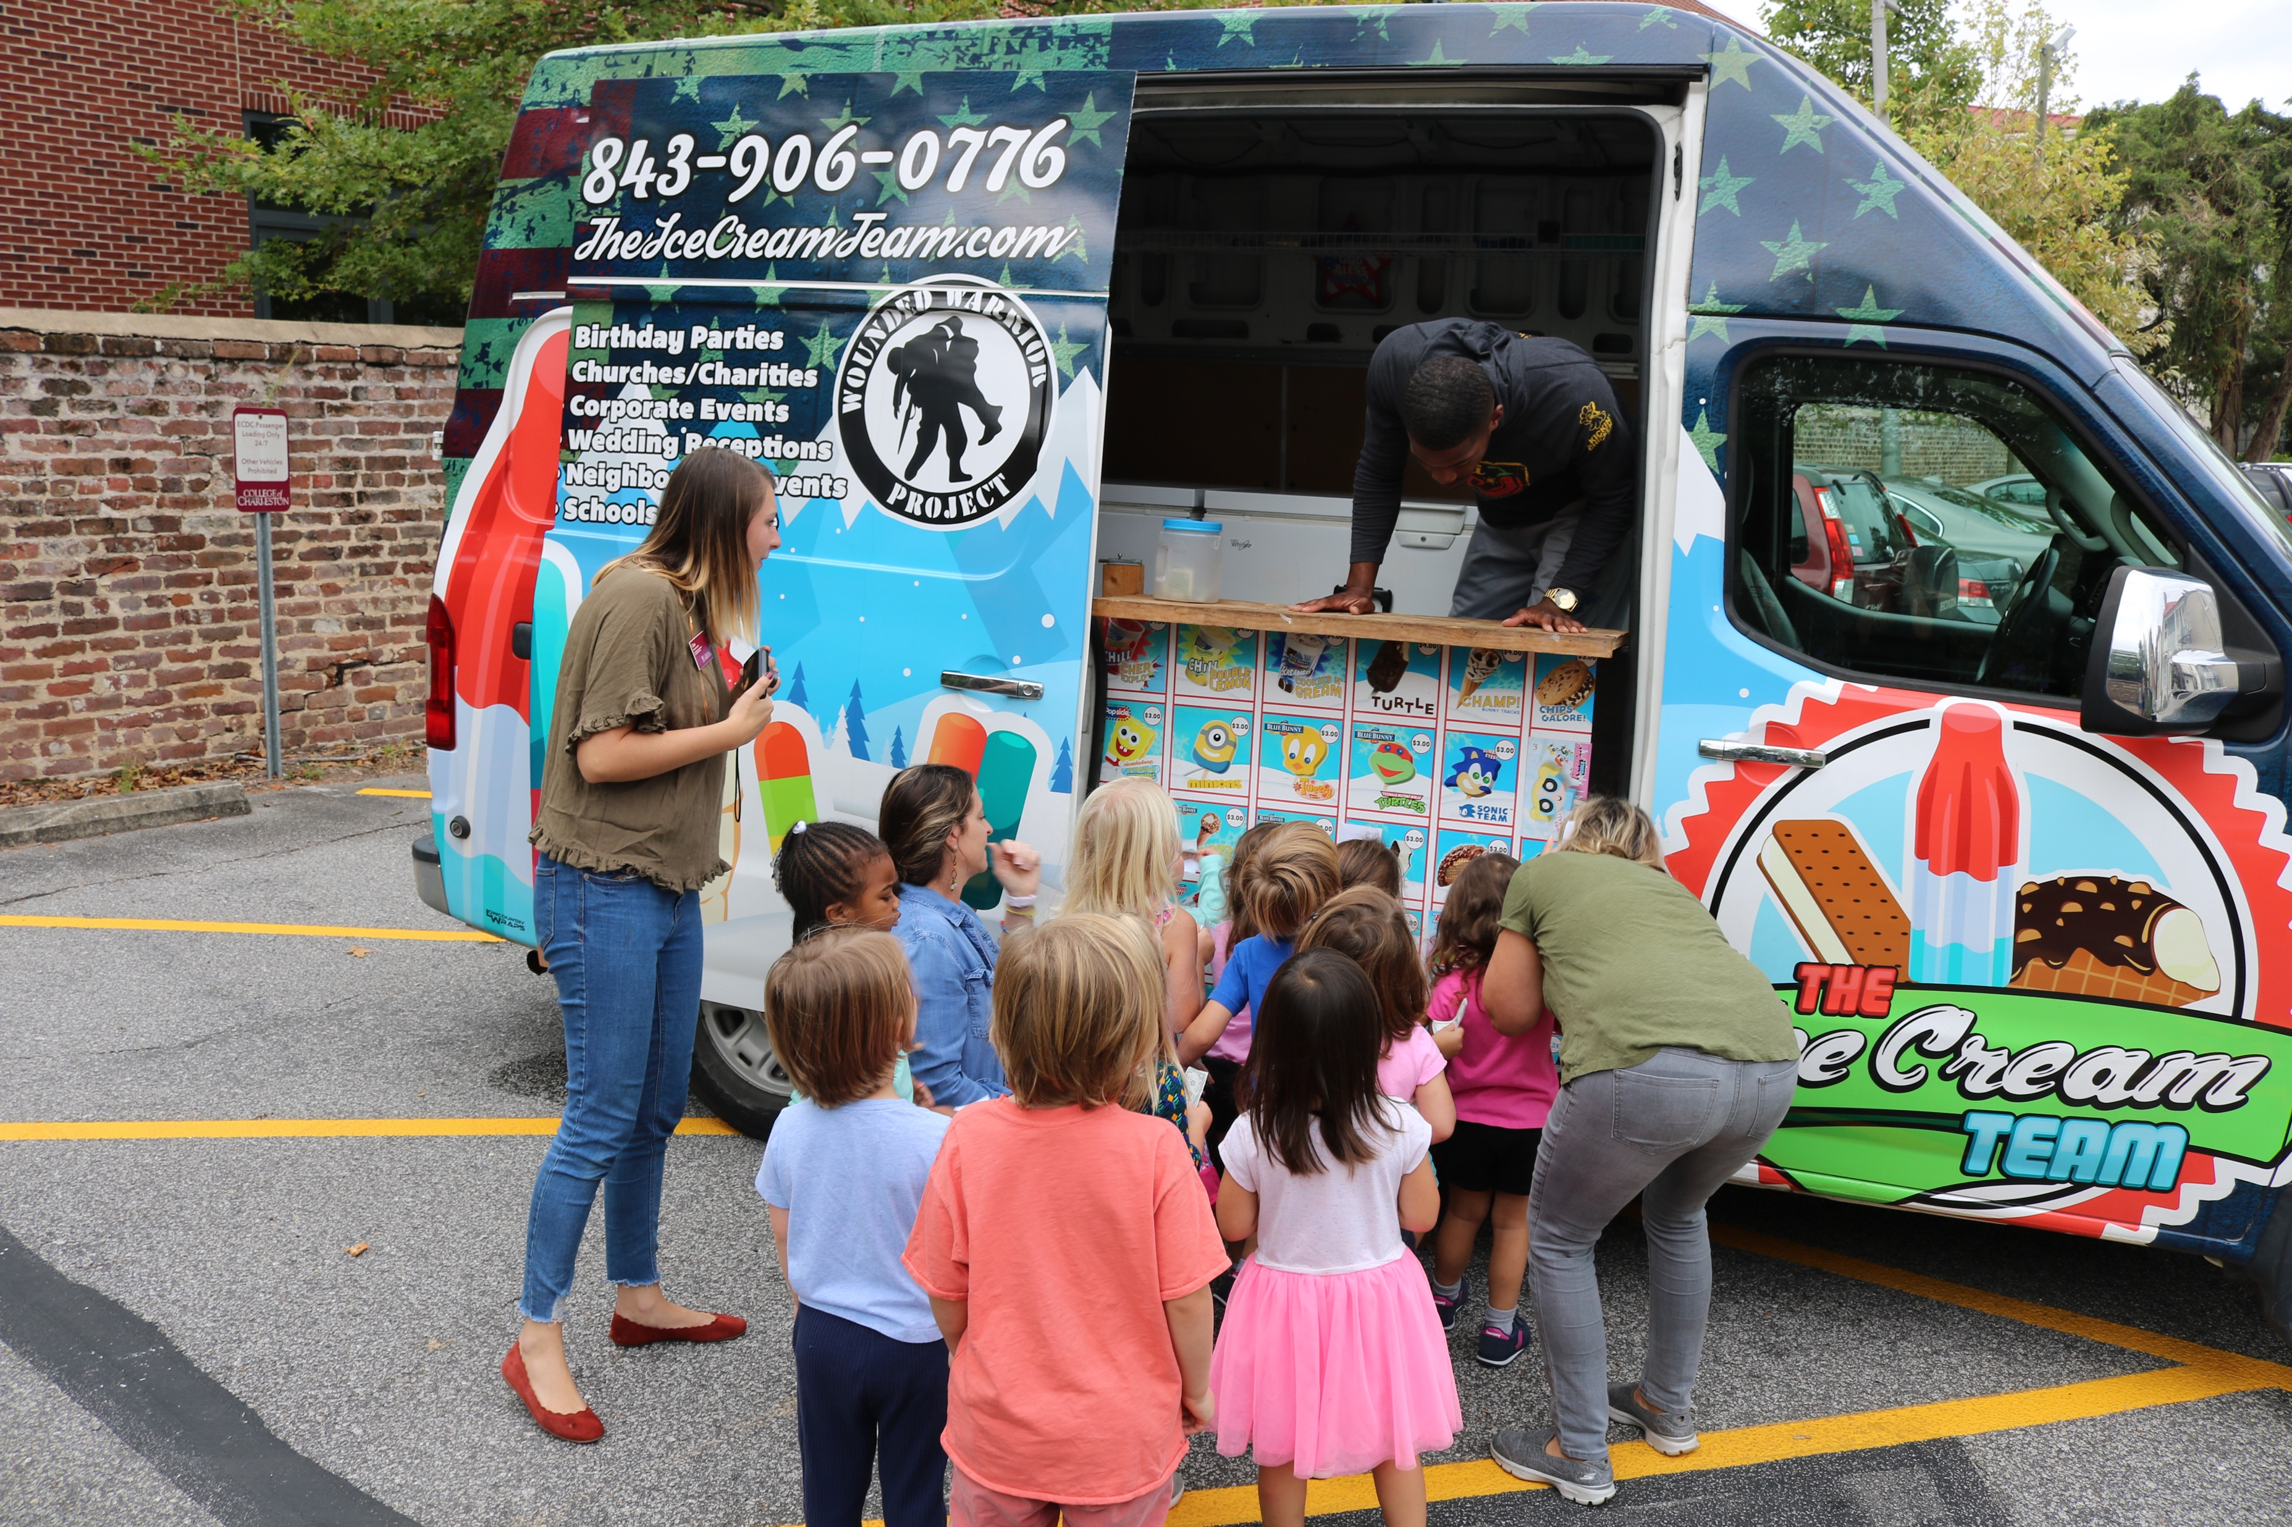
The children created Peace rocks for the Peace Garden that was established in the shared spaced between the schools.
The children celebrated their new friendships and love for nature with an ice cream play date.

Slide 6
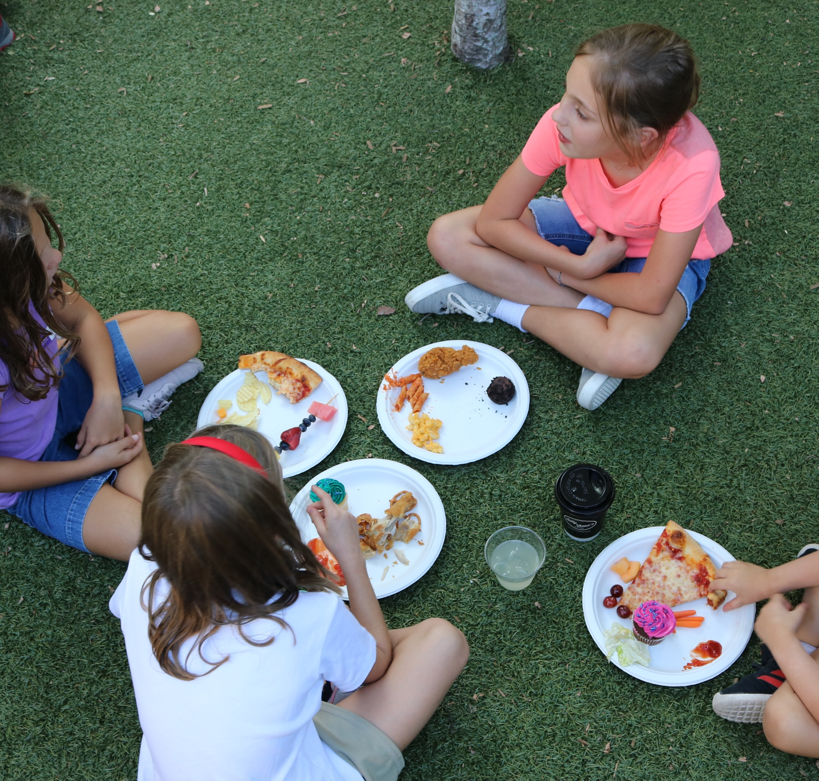
Family Picnic
This year’s Family Picnic celebrated “Campus Children’s Week” and International Peace Day. Families were engaged in activities on the playground that explored the concepts of friendship and Peace.

Slide 7
Routines
Routines and daily hands-on activities continue to be an enjoyment for our students. The children assist with taking care of the garden beds and help with daily maintenance. The campus grounds crew often visits to help the children learn about our plants around the playground.

Slide 8
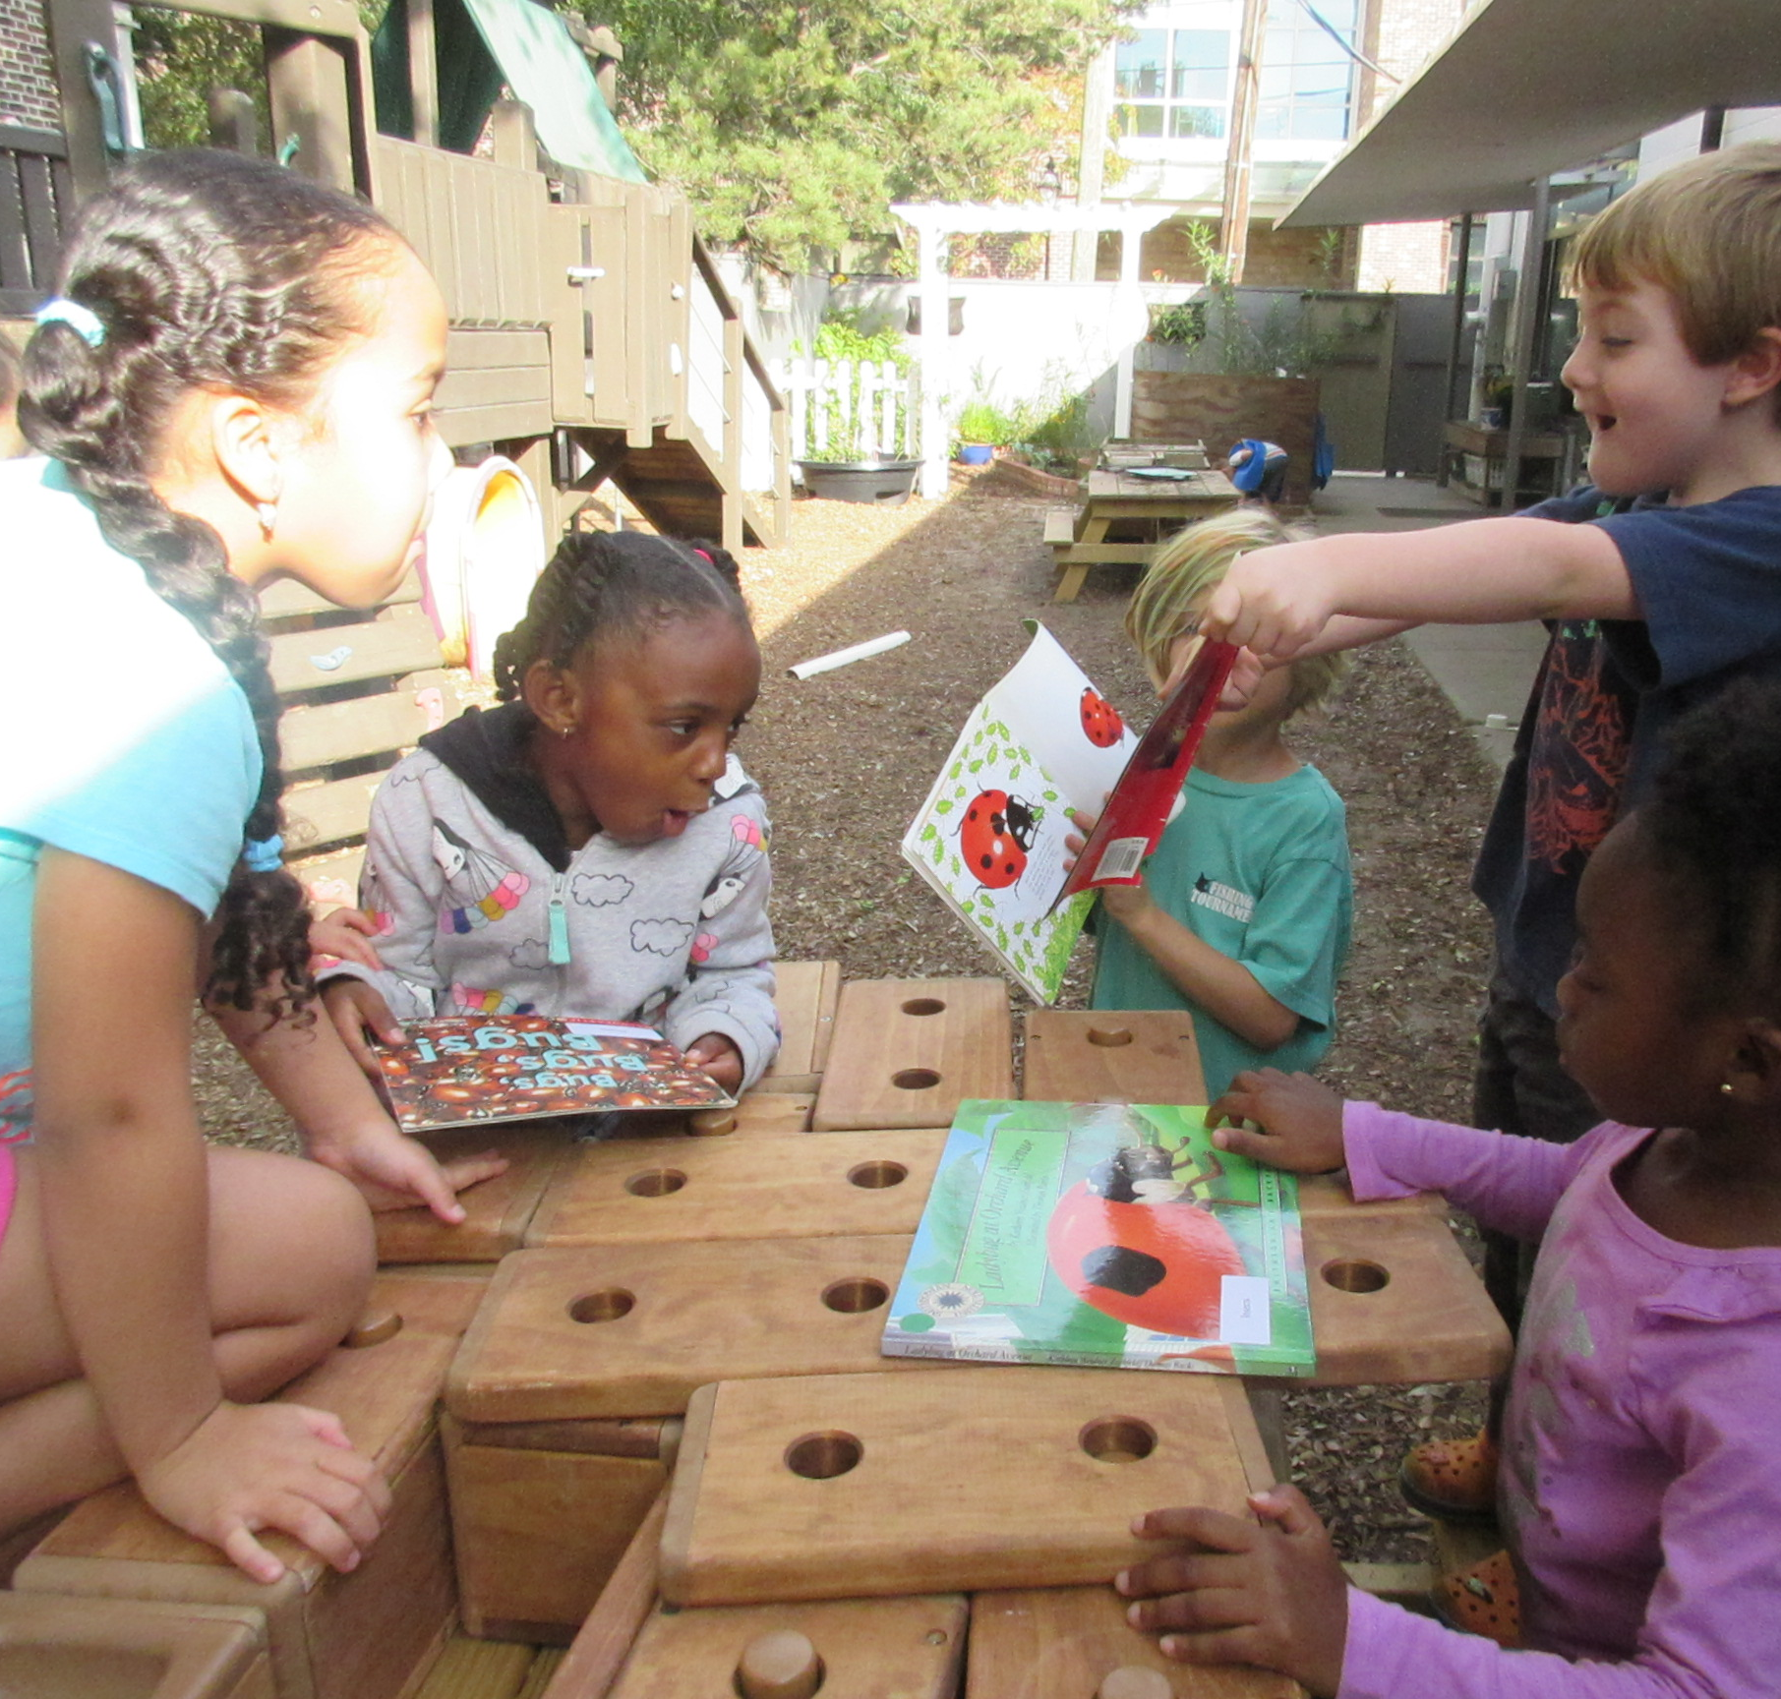
Learning about habitats and animals around us
This year the children studied life cycles and inquired about ladybugs. They observed the ladybugs in their natural habitat, recorded their observations, and created a ladybug hotel.

Slide 9
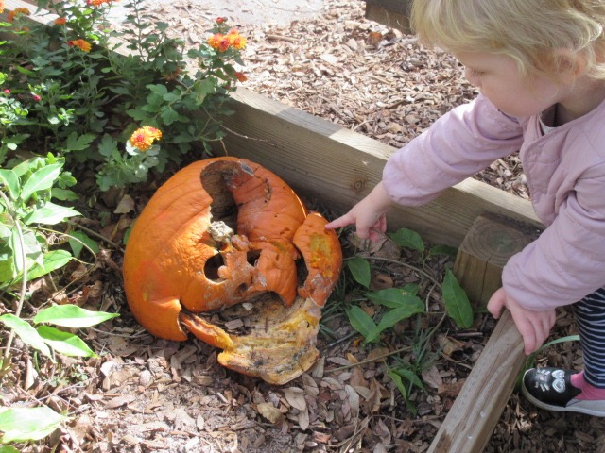
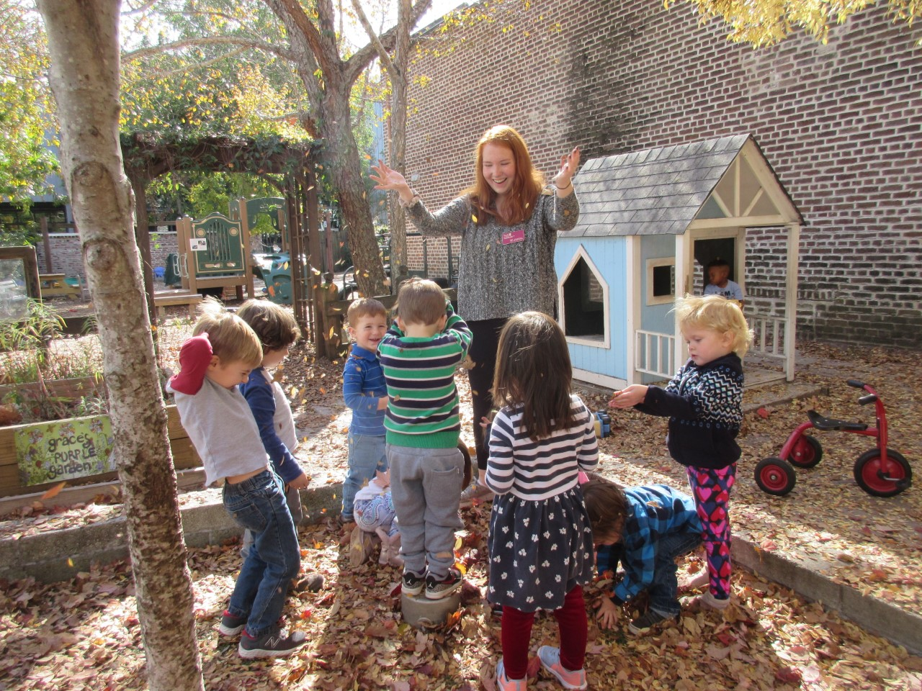
Learning about habitats and animals around us
Our outdoor space invites the children to observe the natural changes in the seasons and the process of how plants decompose.

Slide 10
Loose Parts
The children develop their imagination in child centered play all the time. They are able to explore a variety of loose parts including carboard boxes, wood, pulleys, towel tubes, paper bags, fabric, and outdoor objects they discover on the playground or from our nature walks. This year they discovered more about the concept of force and simple machines.

Slide 11
Loose Parts
Our outdoor area continues to foster imagination, exploration, and risk taking. The children are able to use loose parts in a variety of ways to expand their creativity.

Slide 12
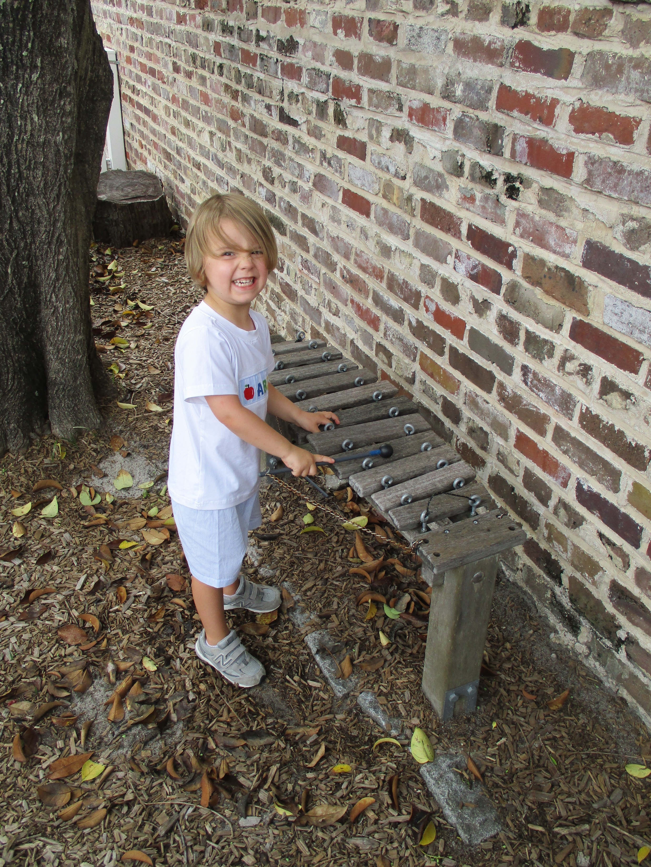
Music and Art in Nature
Children engage with the natural environment in a variety of ways including through music, arts, and developing gross motor skills.

Slide 13
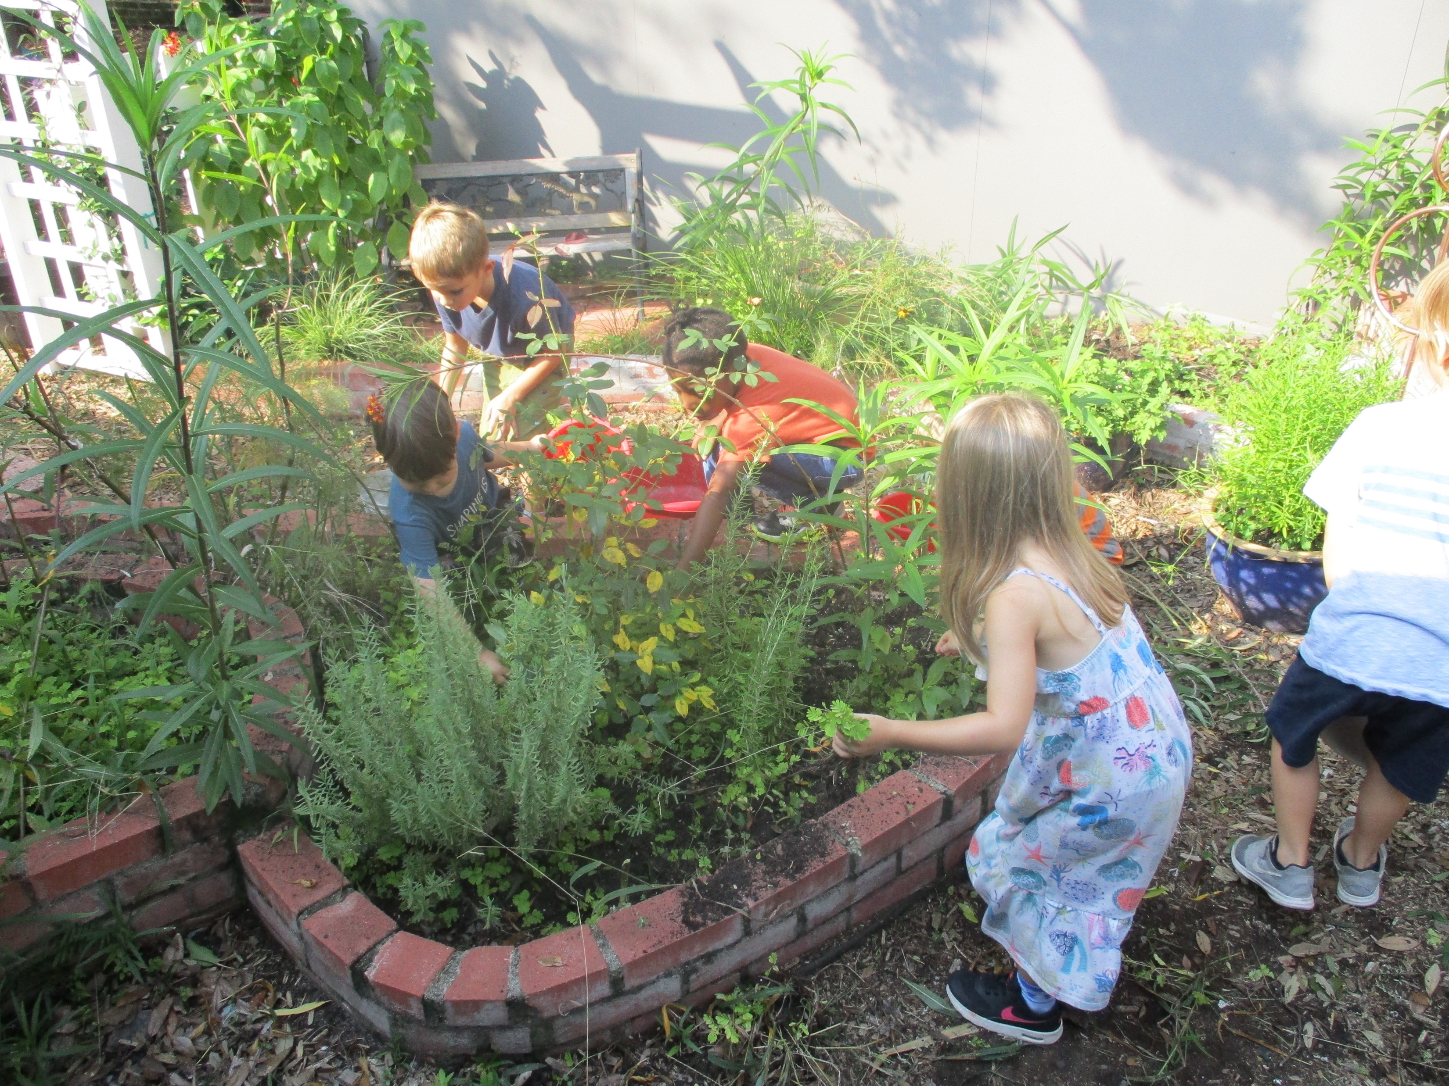
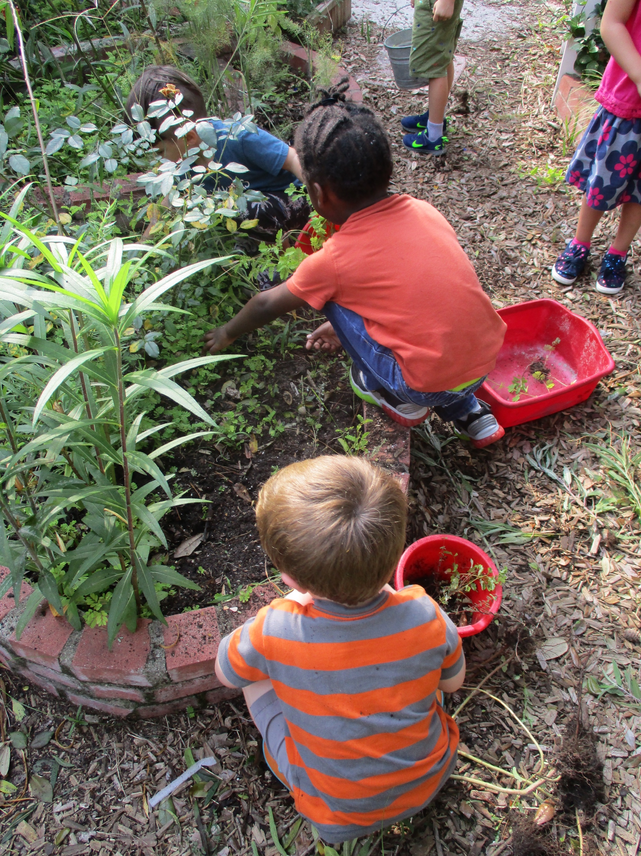
The Garden
Gardening continues to be a focal point of outdoor life at ECDC. This fall the children helped to plant the garden and observed the growth that took place daily. The children make ongoing discoveries and observations in the garden.

Slide 14
2019-20 Professional Development
Our lead staff delivered or participated in the following conferences to continue developing our role as advocates for outdoor education
NAEYC Conference, November 2019
ACT Conference, October 2019
Annual MEPI (Montessori) Conference, February, 2020

